Slide 1
COVID-19 (coronavirus) Communications
Communications Subgroup

Slide 4
Comparison US Influenza to COVID 19
 | Influenza | COVID 19
Illness | 32,000,000-45,000,000 | 100
Medical Visits | 14,000,000-21,000,000
Hospitalizations | 310,000-560,000 | 17
Deaths | 18,000-46,000 (125 pediatric) | 6 (0 pediatric)
Mortality | 0.02% | 2.0% (probably overstated due to testing strategy)
2019-2020 influenza season through February
COVID 19 data January 19, 2020- March 3, 2020

Slide 5
COVID 19
Mortality primarily in those with pre-existing heart and lung disease and elderly
Overall mortality is probably overstated- testing bias to those who need hospitalization
Estimated over 80% will have mild illness not requiring intervention
Fear factor- retailers running out of hand sanitizer, disinfectant wipes, masks, supply theft from medical offices of concern

Slide 6
Recommendations
Airborne Isolation rooms sufficient
Staff protection/PPE similar other respiratory pathogens
Wash hands, stay home when ill, cover mouth/nose when sneezing or coughing
Testing kits still in short supply although expanded access to 93 labs
At this time testing approval through health department; persons under investigation form available on pulse
Avoid coming to ED unless need hospitalization
Avoid visiting physician unless necessary; call ahead; masks upon entry

Slide 7
System Office Incident Command Members
Name | Role
Tammy Lundstrom | Captain
Rachel Nelson | Public Information Officer (PIO)
Gay Landstrom | Nursing
Mandi Murray | Legal
Russell Olmsted | Infection Prevention Management
Darren Vianueva | Supply Chain – System Support
Ed Hisscock | Supply Chain
Meena Rupani | Pharmacy
Ruth Goodell | Risk Management
Martha Murphy | HR
Fred Carmen | Supply Chain
Dameka Miller | Supply Chain
John Schwartz | HR
Sharon Hull | Accreditation and Regulatory
Toni Pratt | Finance
Mary Ann Dillon | Mission
Mario Brunetta | Mission

Slide 8
Communications Subgroup Members
Name | Ministry | Role
Rachel Nelson | System Office | PIO
Maria Seyrig | System Office | Media Lead
Sofia Gaudioso | System Office | Project Lead
Bret Gallaway | System Office | Executive Lead
Jodi Garrett | System Office | Brand Lead
Jody Lamb | System Office | HR Communications Lead
Stef Frenkel | System Office | Contributing Member
Ned Burels | System Office | Contributing Member
Kevin DiCola | Michigan | Contributing Member
Angela Klinske | Michigan | Contributing Member
Tim Delaney | Maryland | Contributing Member
Melissa Lander | Ohio | Contributing Member
Cindy Kalis | Ohio | Contributing Member
Mark Snider | Idaho | Contributing Member
Chris Vicik | Illinois | Contributing Member
Jennifer Krajnik | Idaho | Contributing Member
Letty Ramirez | Idaho/Oregon | Contributing Member

Slide 9
Communications Process
All communications requests should be sent to Rachel Nelson (PIO)
Communications will be created by the communications subcommittee
No communications should be created outside of the communications subcommittee
Any new communications from incident command will take precedence over and should replace pre-existing local signage
All final communications must be approved by the PIO, who will also get approval from the Incident Command Leader

Slide 10
Overall Marketing/Communications Expectations
Contact System Office regarding appropriate communications protocols
System Office direction will include legal, clinical, and CDC guidance and should be explicitly followed
Position marketing and communications as council for the community, our colleagues, and providers by:
Treating COVID-19 as a public health issue, not a marketing opportunity
Encouraging patients to implement preventive measures and virtual screening
Discouraging possibly symptomatic patients from showing up at facilities without advance notice
Protect other service lines and revenue streams by limiting facility exposure to COVID-19 to what your facility resources can handle

Slide 11
Marketing/Communications Subgroup Expectations
All members are contributing members
Members will actively participate in the development of materials and communication
Completed communications will come back to subgroup for approval and then go to Incident Command for final approval
All communications will utilize previously approved templates

Slide 12
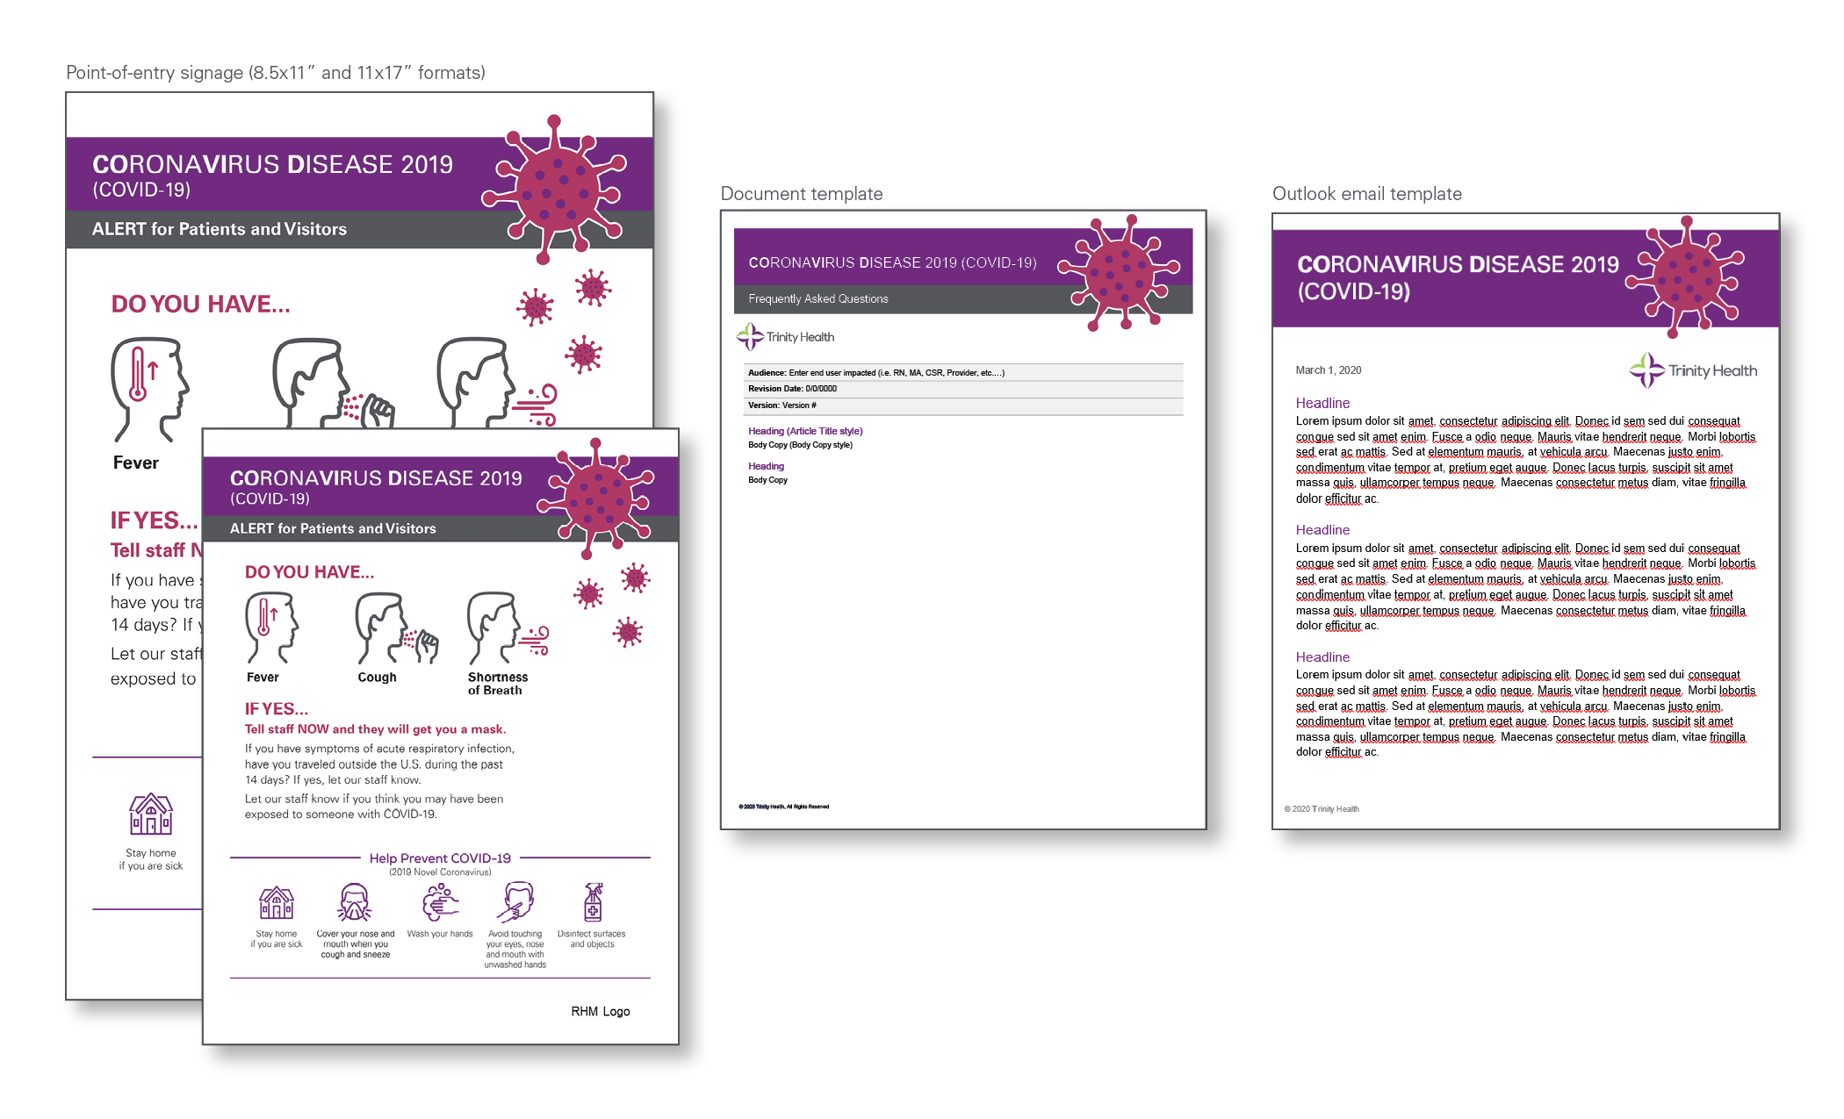
COVID-19 Communications Templates

Slide 13
Media Inquiries
The following guidelines are for Ministry communications teams to prepare for and respond to COVID-19 cases and/or media inquiries.
Please send all national media inquiries to Maria Seyrig or Bret Gallaway Trinity Health Communications.
Local media guidelines:
Only local media inquiries/pitches which are oriented toward public health information should be done at this time.
For these interviews, please only provide content following CDC recommendations.
These interviews should not take place in EDs, Urgent Care Centers or isolation rooms.
Please do not participate in stories related to hospital preparedness, supply chain, medical supply stock, testing, etc. For the local area approach to handling some of these topics, please refer media to your local health officials for response.
If you have an inquiry which strays form this approach, please escalate through Trinity Health's Communications team for legal and leadership approvals.
Work with the public information officers from your local or state public health offices to ensure alignment with their media strategy.
In your messaging, reinforce CDC recommendations that patients should call ahead before coming in to receive direction, unless it is a life-threatening emergency.
As always, follow established protocols for patient privacy in accordance with HIPAA for all media inquiries.

Slide 14
Additional Media Guidelines
We are escalating the policy to automatically pull all suspected cases from directories and not confirming to media.
Patient/ Family Relations: To mitigate leaks, if you have a person under investigation (PUI) for COVID-19, establish a relationship with the patient, patient’s family or representative to help advise on patient privacy, including their option to remain private. Impart awareness regarding how privacy may benefit their family throughout this process:
If patient wishes to remain private, ensure the patient is removed from the directory, and advise colleagues of privacy request.
If a patient wishes to go public with his/her diagnosis, advise family of the importance of appointing a spokesperson, of regulations around naming colleagues/staff, and of the policy that no interviews, filming or cameras are allowed on or in the hospital/facility, etc.
Remind colleagues and clinicians on the affected unit to ensure the highest level of privacy and to refer any media inquiries to the ministry communications team.

Slide 15
Current Approved Media Statements/Talking Points
[General]
[Ministry name] is a member of Trinity Health, which is a national health system that communicates regularly with the Centers for Disease Control and Prevention to help protect our communities from infectious diseases. All Trinity Health hospitals, including [ministry name], follow CDC protocols for evaluating and reporting potential cases of COVID-19 and all other infectious diseases.
Suspected cases will go through channels established by the CDC for diagnosis confirmation. Patients who present with symptoms, as outlined by CDC, and have recently traveled or been in close proximity with someone who has traveled to affected areas, are immediately isolated.
More information about COVID-19 is available at the CDC website.
[If asked about a specific patient]
[Ministry name] protects the privacy of our patients and does not comment on their treatment, and that includes commenting on whether or not a person is a patient at our hospital. [Refer them to the CDC]

Slide 16
Current Approved Media Statements/Talking Points cont.
Is there a protocol for the hospital to deal with a crisis like this?
We have implemented screening guidelines that allow us to rapidly identify and isolate patients who may have COVID-19. We routinely update plans and procedures to prepare for outbreaks of illness. People who have symptoms of COVID-19 (see CDC website), should call their doctor before coming to a doctor's office, urgent care, or emergency department.
Is the hospital prepared to quarantine people if need be from the virus? How would they do this?
All [Ministry Name's] individual hospitals [OR Ministry Name] are/is equipped with negative pressure patient rooms and will retain rather than transfer patients who require a hospitalization. These rooms are used for all infectious disease that requires isolation. Patients who are asymptomatic would be discharged for home quarantine if medically appropriate and monitored daily by the local health department. The majority of people with COVID-19 do not require hospitalization, similar to the flu.
What happens if the hospital reaches its capacity?
We are able to transfer both to other hospitals within our health system or other hospitals in our region using standard diversion protocols.
What specifically is your health system doing to prepare for the Coronavirus?
Ministry Name] is closely monitoring the evolving situation related to the 2019 Novel Coronavirus (COVID-19) and updating our strategies in real time as we work in partnership with our local and state health departments, and with guidance from the Centers for Disease Control and Prevention.

Slide 17
Current Approved Media Statements/Talking Points cont.
[General Prevention Information from the CDC]
The best ways to prevent infection and spread of diseases like COVID-19 include:
Avoid close contact with people who are sick.
Avoid touching your eyes, nose, and mouth.
Stay home when you are sick.
Cover your cough or sneeze with a tissue, then throw the tissue in the trash.
Clean and disinfect frequently touched objects and surfaces using a regular household cleaning spray or wipe.
Wash your hands often with soap and water for at least 20 seconds, especially after going to the bathroom; before eating; and after blowing your nose, coughing, or sneezing.
If soap and water are not readily available, use an alcohol-based hand sanitizer with at least 60% alcohol. Always wash hands with soap and water if hands are visibly dirty.
More information about COVID-19 is available at the CDC website.
If you have questions, please contact, Maria Seyrig or Bret Gallaway Trinity Health Communications.

