Slide 1
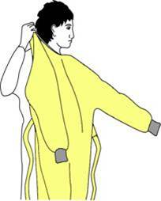
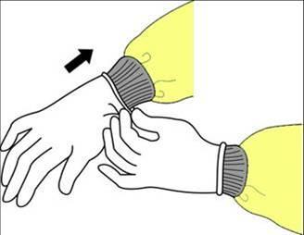
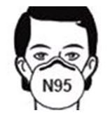
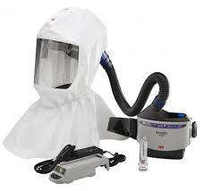
CONTACT + AIRBORNE
+ EYE PROTECTION
PRECAUTIONS
Only staff necessary for care allowed entry to room
Wash hands upon entering
Use sanitizer or soap & water
Wear an Isolation Gown
& Gloves when entering
Wear an N95
AND Face Shield
OR a PAPR
Remove gown, gloves, mask/face shield or PAPR, and wash your hands upon leaving the patient's room
NO VISITORS WITHOUT PRIOR APPROVAL
KEEP DOOR CLOSED

