Slide 1
Benefits Orientation
Introduction to the Video Series
Notes:
Approximate run time = 2:30

Slide 2
Our Mission
We, Trinity Health, serve together in the spirit of the Gospel as a compassionate and transforming healing presence within our communities.
Our Core Values
Reverence
Commitment to Those Who are Poor
Safety
Justice Stewardship Integrity
Our Vision
As a mission-driven innovative health organization, we will become the national leader in improving the health of our communities and each person we serve. We will be the most trusted health partner for life.
©Trinity Health 2020, All Rights Reserved
Notes:
Welcome to Trinity Health. Whether you’re joining us as a front-line caregiver, or in a non-clinical role, we believe you'll find Trinity Health to be a very special place to work. Here's why:
Our Mission is to be a compassionate and transforming healing presence within our communities…where the people we serve are at the center of every behavior, action and decision in our ministry.
You are joining a dedicated team who are living our Core Values of reverence, commitment to those who are poor, safety, justice, stewardship, and integrity, every day.
40 seconds

Slide 3
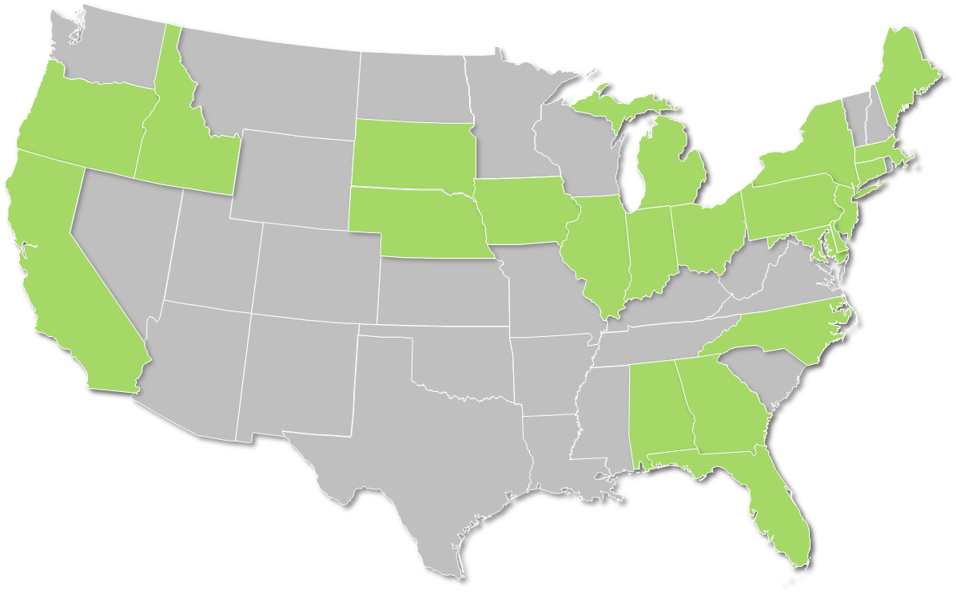
Today, Trinity Health is a 22-state national leader in health care
$19.3B
In Revenue
1.5M
$1.2B
Attributed Lives
Community
Benefit Ministry
129K
7.5K
28.0K
Colleagues
Employed Physicians & Clinicians
Affiliated
Physicians
92
18
13
109
64K+
Hospitals*
Clinically Integrated Networks
PACE
Centers
Continuing Care Locations
Babies Born Each Year in Trinity Health Hospitals
Data above is for FY19 *Owned, managed or in JOAs or JVs
Notes:
As one of the nation’s largest health care systems, we deliver care to more than 5 million people annually through our diversified network. It includes hospitals, continuing care locations, as well as thousands of physician offices and outpatient facilities.
18 seconds

Slide 4
Our Tax-Exempt Status
A Ministry of Hope and Healing
Trinity Health and its Health Ministries are all not-for-profit organizations.
We reinvest our funds into our Health Ministries and the community instead of distributing profits to shareholders.
We have a charitable purpose – it is our Mission.
Notes:
Trinity Health and its Health Ministries are all not-for-profit organizations.
We reinvest our funds into our Health Ministries and the community instead of distributing profits to shareholders.
We have a charitable purpose – it is our Mission.
20 seconds

Slide 5
Our colleagues are key to achieving our Vision
As a mission-driven innovative health organization, we will become the national leader in improving the health of our communities and each person we serve.
We will be the most trusted health partner for life.
Notes:
Colleagues are key to helping us achieve our Vision to be the most trusted health partner for life.
By joining Trinity Health you are now part of a leading effort to transform health care in America and make positive changes in our communities.
16 seconds

Slide 6
Trinity Health provides comprehensive benefits
Live Your Whole Life
Benefits designed to support your health and well-being – body, mind and spirit
Video series provides high-level overview of comprehensive benefits available
Visit HR4U to review detailed benefit documents
https://hr4u.trinity-health.org
Notes:
At Trinity Health, we are committed to supporting the health and well-being of those we serve, including our colleagues.
This video series is designed to provide a high-level overview of the comprehensive benefits available to help you Live Your Whole Life – body, mind and spirit.
For more detailed information, and to review plan documents, see your new hire information and visit the H-R-4-U colleague portal.
26 seconds

Slide 7
Check out all the episodes in the video series
Live Your Whole Life
Medical and pharmacy
Health Savings Account
Essential Assist with Health Reimbursement Account
Flexible spending accounts
Dental and vision
Life Insurance/AD&D
Time Away from Work
Voluntary benefits
Retirement program
Well-being / Employee assistance program
Other benefits
Eligibility and enrollment
Notes:
We encourage you to explore all the episodes in the video series so you can make an informed decision about the benefits that are right for you and your family.
10 seconds

Slide 8
Important Information
The information provided in this summary is designed to assist you with understanding your options under Trinity Health’s welfare benefit plans and programs. It is only an overview and is not intended to be a comprehensive description of the benefit plans and programs available to you. It does not constitute a contract and is not meant to interpret, extend or change any plan or program provisions in any way. The summary plan descriptions and official plan and program documents describe the plans and programs in more detail and you should refer to these documents for answers to your specific questions regarding the plans and programs, including what services are covered by a plan. If there is a discrepancy between printed materials, the official plan and program documents will prevail. Trinity Health retains the right to make changes to or terminate its benefit plans and programs at any time, including making changes to comply with and exercise its options under the Affordable Care Act and other applicable laws.
To view the summary plan descriptions and certificates of coverage, visit the HR4U colleague portal at https://hr4u.trinity-health.org. For any plan or program in which you participate, you also have the right to request a full printed copy of the summary plan description or certificate of coverage and other official plan or program documents from the colleague’s employer or Trinity Health Total Rewards Benefits & Well- Being, 20555 Victor Parkway, Livonia, MI 48152. There will be no charge for the printed copies.
All Trinity Health group health plans provide care coordination, care management, utilization review and referral services to help manage the healthcare provided to covered members. By enrolling in a Trinity Health group health plan you understand that the plan will provide services to manage each covered member’s care. These services may be provided through independent third-party administrators, a clinically integrated network of hospitals, physicians and other health care providers and professionals and other healthcare providers. Your participation in a Trinity Health group health plan means that the persons contracted to provide these services will have access to your personal health information, including health information you disclose through wellness programs and well-being activities. Trinity Health facilities and healthcare providers and professionals affiliated with Trinity Health facilities participate in certain clinically integrated networks. You may be contacted about your health care by a clinically integrated network, including by individuals at a Trinity Health facility or provider who are performing services for the clinically integrated network or directly for the group health plan. Information about your medical treatment at any facility and from any healthcare provider or professional may be accessed and used by individuals who work at a Trinity Health facility or provider (including your employer) participating in a clinically integrated network or the group health plan not only for treatment but also to manage and coordinate your healthcare. Any access to, use or disclosure of protected health information will comply with the privacy and security regulations under the Health Insurance Portability and Accountability Act and any applicable state privacy and security laws.

