Slide 1
Colleague Care
National Check-in
November 17, 2020

Slide 2
Welcome – Colleague Care National Check-in
kp
Thank you for joining us today! We will begin momentarily.
Please keep your Mic on MUTE when you are not speaking to minimize background noise.
If you are calling from a facility phone, please do NOT put us on HOLD - we will hear your hold music or messages.
We invite you to use your video camera if you have one as we begin and when you are speaking
If you have a question or comment, please let us know by speaking or by using chat feature.
This meeting is being recorded.
The link to recording and slides will be sent to you following our Check-in.

Slide 3

Today’s Agenda
kp
Time (ET) | TOPIC | LEAD
2:00 pm | Welcome Agenda Review Reflection ­­­­ | Kelly Putnam (kp), Director, Organization Effectiveness Mario Brunetta, VP Mission Integration
2:05 | Leadership Update | Dr. Tom Peterson, Chief Safety Officer
2:10 | Featured Presentation: SAHS Colleague Care | Sheri Ainsworth, Mission Integration Saint Alphonsus Health System Colleague Care
2:40 | Task Force Updates | Communication – Jody Lamb, Manager, Communications Resource Reminders – Jim Purvis, Innovation Consultant, Strategic Innovation
2:50 | New Ideas and Best Practices | Jim Purvis, Innovation Consultant, Strategic Innovation
3:00 | Adjourn

Slide 4
Reflection
Mario Brunetta
Vice President, Mission Integration
Trinity Health System Office

Slide 5
Opening Comment
Tom Peterson
Chief Safety Officer

Slide 6
Opening Comment
Thank you for your commitment to colleague well-being
  In October, across the system, 442 rounders supported this work.
  These rounders attended 1,060 huddles and had 1:1 interactions (in person, telephonically, or virtually) with 7,404 colleagues.
  Cumulatively, our rounders have attended 3730 huddles and had 18,277 1:1 interactions with colleagues since we began tracking metrics in July.

Slide 7
“Safety is a Core Value at Trinity Health.
Our goal at Trinity Health should be leveraging our skills, scale, and learning as a national system to be the safest healthcare system in America”
Mike Slubowski
President and CEO of Trinity Health

Slide 8
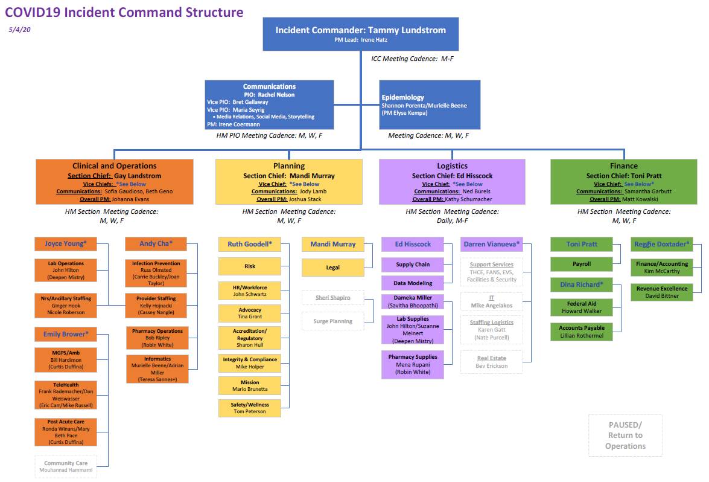
Cross-functional TogetherHealth Emergence Teams are addressing strategic initiatives. We are leveraging this structure and process to expand Team 5 and add two additional teams.
Emergence Steering Team
Financial Planning/
Modeling
Team: ELT, Led by Mike, Ben, Dan; How do we emerge from COVID-19 crisis as a stronger, more efficient coordinated care organization per our TH2023 strategy?
Note: COVID-19 Incident Command will continue to address pandemic-related issues.
Team: Led by Cindy Clemence and Dan Isacksen; What will our financial position look like with COVID-19 now and in the future? How do our capital plans change now and in the future?
New
Teams
1. Safe OP/Elective Ramp-Up
2. National Virtual &
In-Home Care
3. Optimize
Non-Acute Configuration
4. Operating Model Size & Scope
5. Delivery System
Design & Configuration
(Multiple Parallel Teams)
6. Culture/
TogetherHealth Experience
7. Safety/
Zero Harm
Led By: Dr. Reggie Eadie & Julie Washington
Kickoff: April 17
Key Question: How to safely ramp up care delivery during Phase II to have a first-mover advantage in markets?
Led By: Marcus Shipley & Dr. Mark LePage
Kickoff: May 1
Key Question: How to leverage our scale and the current environment to grow member relationships and accelerate portfolio diversification?
Led By: Mike Englehart & Rob Casalou
Kickoff: May 8
Key Question: How do we optimize use and configuration of current ambulatory, MGPS, and continuing care service locations?
Led By: ELT
Kickoff: Early May
Key Questions: How do we right-size given immediate COVID impact?
How do we design the NEW Trinity Health operating model?
Led By: HM’s TH2023 Teams
Kickoff: July-
September
Key Questions: What is our HM strategic plan?
How do we redesign local HM footprints & service config-urations to gain economies of scale and member relationships?
Led By: Segment Dev’t Teams TBD
Kickoff: H1, FY20
Key Question: How do we develop and grow four new health segments (Specialty Pharmacy, Health & Wellness Retail, Physician Practice MSO, Innovation Venture Fund) in our portfolio?
Led By: Lorraine Lutton and Ed Hodge
Key Question: How do we refine our culture to deliver on our D&I commitment and consistently demonstrate the TogetherHealth experience and brand promise to all members – colleagues/each other, physicians, and people in the communities we serve?
Led By: Odette Bolano and Tom Peterson, M.D.
Key Question: How do we create a safe/zero harm environment for all members – colleagues, physicians and people we serve in our communities?
Emergence Support Team
Led by Ben Carter, with daily huddles
©Trinity Health 2020, All Rights Reserved
Notes:
As a result of our positive experience with Incident Command during the COVID-19 crisis, we launched what we have named “Emergence Teams” to rapidly address many of our system strategies. These teams are co-led by a Health Ministry CEO and a System Services leader. Team 1 led the development of our guidebook for safe resumption of outpatient and elective services. Team 2 is developing our strategy and services to leverage use of virtual care. Team 3 has developing and is implementing a new configuration of our outpatient and continuing care locations. Team 4 led the work for our right-sizing and also developed the recommendations for changes to our operating model. Team 5 led the identification of new services to launch, and also is matching that system-wide plan with the specific strategic plan updates of each Health Ministry. We are now launching two more teams – one focused on our culture to deliver on our TogetherHealth experience for our customers, and another that is focused on creating a safe, zero-harm environment for colleagues and patients.

Slide 9
Emergence Team 7 and Sub-Teams
Team 7
Safety / Zero Harm
Zero Harm Steering Team
SSE Transition/ Data Team
Safety Teams
THLS/Zero Harm
Colleague Care Team
Leader and Colleague Education
Regional Safety Executive Team
Leads: Odette Bolano, Tom Peterson
Single system-wide team that coordinates/cascades information through SLE/MLC
Lead: Tom Peterson
All HMs safety executive leadership Communication of strategies
System team
Develop SSE transition
Develop safety scorecard, event reporting and dashboard design
  Develop the four teams to set system standards – begin with sharps, SPHM, WPV
  Establish basic safety infrastructures/governance
Design the x-matrix/ A3’s for Zero Harm
Develop the THLS/Zero Harm Guidebook for THLS/Zero Harm integration
Sustain and build on the colleague care program
Develop and implement the training programs
Develop safety website
Notes:
Two additional sub teams
Colleague care team
Marcomm

Slide 10
Featured Presentation
Saint Alphonsus Health System Colleague Care

Slide 11
Task Force Updates:
VA
Notes:
Appreciation to team for their positivity, focus, engagement during the pandemic and throughout our OE and WPHRA transformation. Reference $600 Appreciation Award coming in November.

Slide 12
Holiday Resource Reminders
Making the Most of the 2020 Holiday Season
Celebrating the Holidays During COVID
COVID-19: Experiencing the Holidays with Heavy Emotions
Watch for Holiday fliers (pdfs) in the post-event e-mail from Live Your Whole Life!

Slide 13
More Resource Reminders
All-colleague facing page:
  https://www.trinity-health.org/colleague-care/
Colleague Care Team page:
https://www.trinity-health.org/covid-19-resources/find-a-resource/colleague-care-leader-resources/

Slide 14
December National Check-in Prep - Two Questions
  What emerging Colleague Care/Resiliency Rounding Best Practices can you share with our network of Accountable Executives and Coordinators?
  What New Ideas are you considering / trying to support colleagues as we navigate another surge?
  Please submit your ideas by December 7, 2020 to Jim Purvis at
  james.purvis@trinity-health.org
  Jim will collate the submissions to drive our group discussion at the December National Check-in on December 15.

Slide 15
Appreciation and Adjourn

Slide 16
Open Forum
Q&A
kp

