Slide 1
Instructions
This education can be viewed by clicking on each slide on the left or by watching it through presentation mode.
To watch through presentation mode, click on Slide Show in the tool bar and then click on from current slide. To advance the slides just click on each slide in the lower right-hand corner.
There are a couple videos in this education as well, to watch the videos click on the play button in the center of the image or follow the prompts on the screen.
This education will take approximately 12 minutes to complete.

Slide 2
Annual Security Awareness Training 2025
Annual Mandatory Security Awareness Training for all APP and Physicians
© Trinity Health, All Rights Reserved.

Slide 3
Welcome & Introduction

Slide 4
Objectives
TogetherSafe and being cybersafe require many of the same good behaviors. You will learn the warning signs of security threats and behaviors that increase security:
Using Strong Passwords
Utilizing Multi-Factor Authentication
Reporting Security Incidents
Demonstrate Safe Email Practices
Recognizing Social Engineering & Phish Warning Signs
Keeping Systems, Devices, and Information Safe
Notes:
Time: ~ 1 minute
SAY:
There are the five Trinity Health TogetherSafe behaviors in the TogetherSafe Toolbox.
Do you recall the shield from the TogetherSafe logo at the beginning of today's session, each and every one of us is accountable for safety
These are the safety behavior expectations for all of us (clinical and non-clinical; inpatient and outpatient; acute and long-term care, etc.) when working at Trinity Health.
FACILITATOR NOTE: Read each behavior.
SAY:
Our goal across Trinity Health is to perform these behaviors daily, until they become habits.
We will also introduce you to tools within each behavior that help make it easier to consistently practice then apply them frequently at the right time.

Slide 5
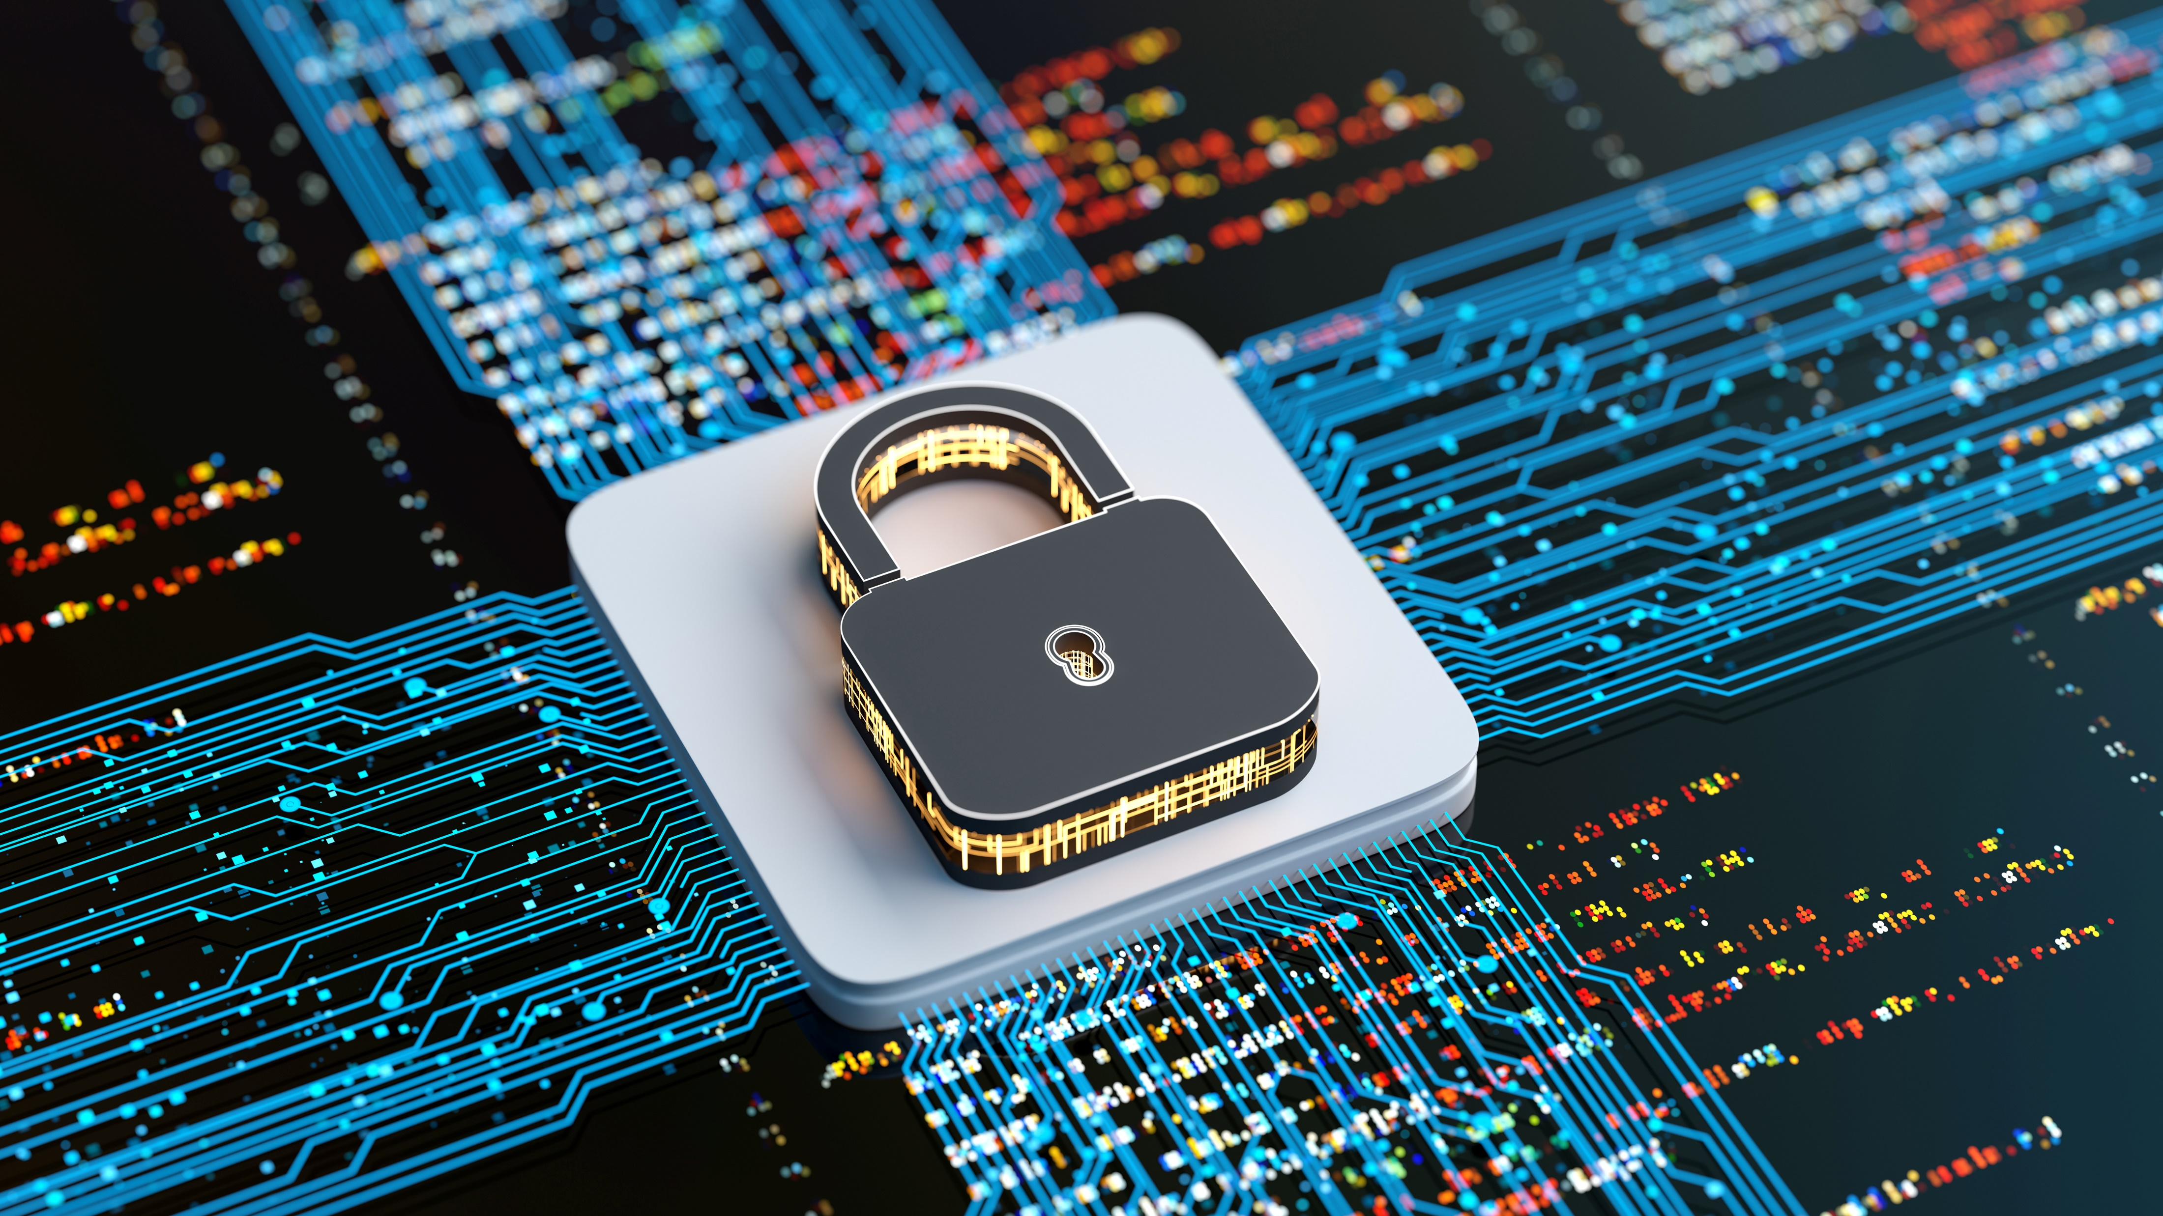
Prepare for the Process and Manage the Task
Using Strong Passwords
Utilizing Multi-Factor Authentication (MFA)

Slide 6
Password Guidelines
Below are password guidelines to follow.
DO
DON’T
Get Creative! Passphrases and sentences are harder to crack.
Reuse passwords on more than one account/site.
Combine symbols, upper- and lower-case characters.
Use single words found in the dictionary.
Use your Trinity Health password on other sites.
Create long passwords
Use easy to guess passwords.
Write passwords down.

Slide 7
Password Policy
Never share passwords and/or credentials, including with other staff members.
Sharing passwords and credentials violates both HIPAA regulations and Trinity Health policy.

Slide 8
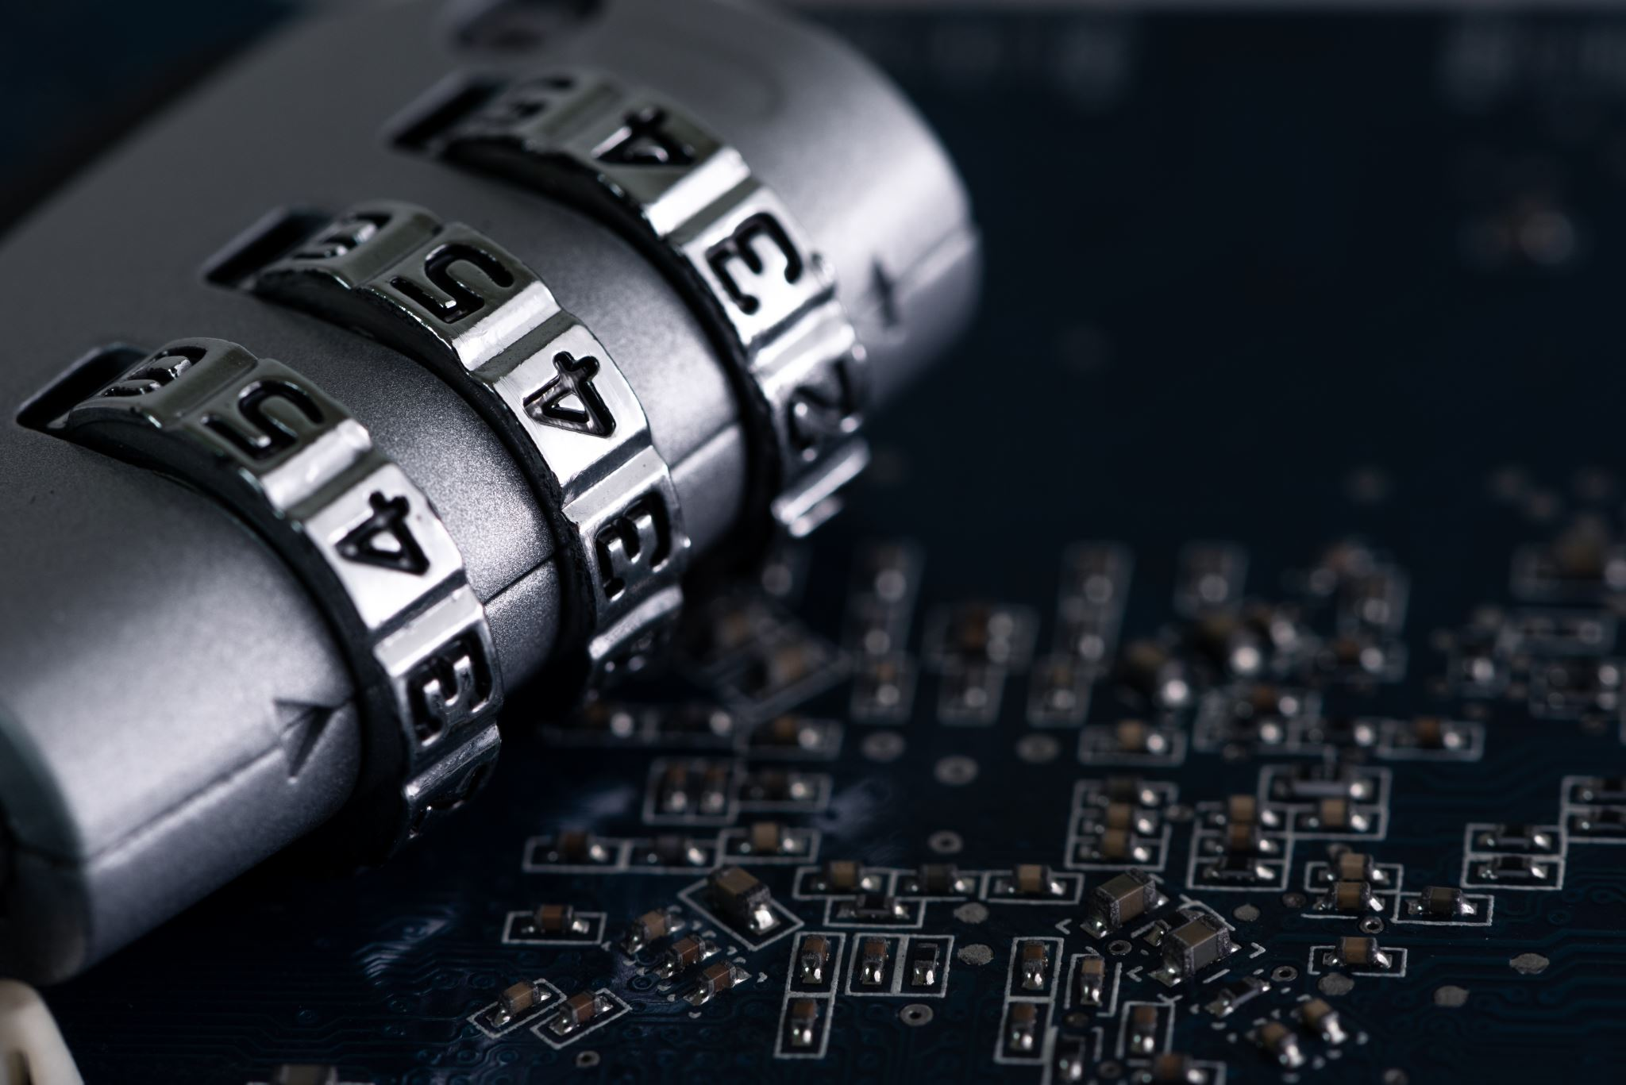
Multi-factor Authentication
MFA is an authentication method that uses two or more distinct mechanisms to validate a user’s identity, rather than just a simple username and password combination.
Users may receive a verification prompt to their mobile device when authenticating to MFA-enabled Trinity Health applications.
At work, colleagues who interface with third parties should always enable MFA on their application(s) when available to protect Trinity Health confidential information
At home, enable MFA when the option is available to ensure both your privacy and security at financial institutions, etc.

Slide 9
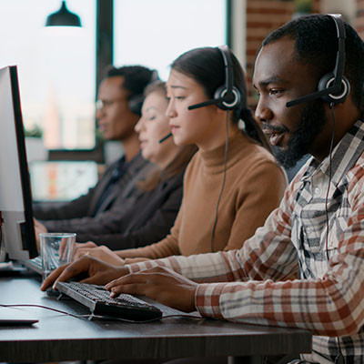
Support the Team
Reporting Security Incidents

Slide 10
Click here to play the video

Slide 11
Report Lost or Stolen Devices
Immediately report all Trinity Health devices and personal devices containing Trinity Health Protected Health Information (PHI) or Personal Identifiable Information (PII) that are lost or stolen.
Notify the TIS Service Desk at (888) 667-3003
Contact your supervisor

Slide 12
Communicate Clearly
Demonstrate Safe Email Practices

Slide 13
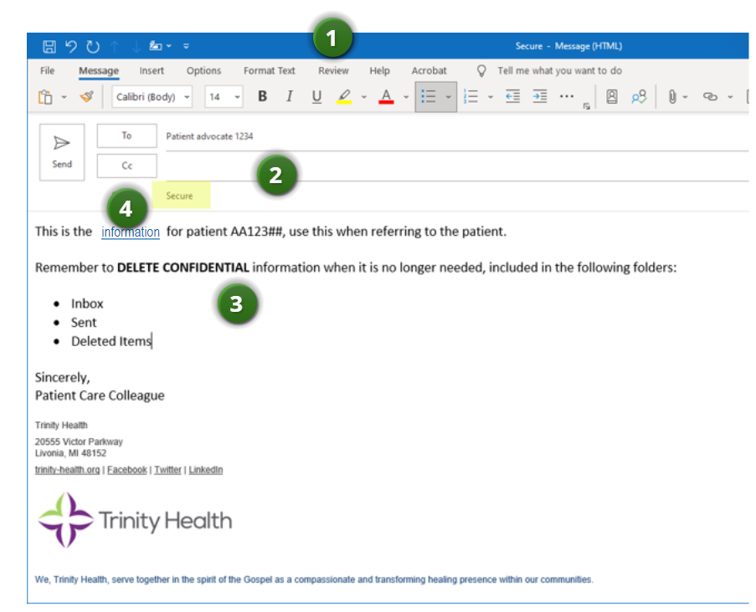
Sharing PHI and other Confidential Information
Use only Trinity Health approved technology to send confidential information.
External sharing of large amounts of PHI should be sent via Trinity’s secure file transfer.
Review the sample email to learn more.
Information Sharing
PHI should only be shared with the “minimum necessary” email addresses requiring the information.
Do not routinely share PHI in distribution lists without verifying each individual’s need to know.
External Sharing
Enter “Secure” in the Subject Line, to encrypt the message before sending externally.
Email Maintenance
Remember to delete messages containing PHI from your Inbox, Sent, and Deleted Items Folders.
Do Not use your email as a file repository.
Internal Sharing
When sharing PHI internally via email, use file links versus attachments for greater protection.

Slide 15
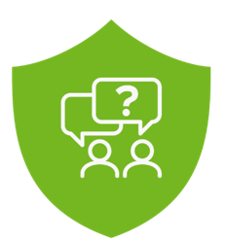
Questioning Attitude
Recognizing Social Engineering & Phish Warning Signs

Slide 16
Click here to play the video

Slide 17
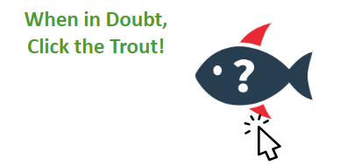
Social Engineering Attacks
Term | Definition | Colleague Action
Phishing | The most common cyberattack by threat actors is the act of sending emails or other messages pretending to be from reputable companies to entice individuals to reveal confidential information such as PHI, PII, passwords, etc. | If the message seems suspicious or raises your emotions, use the Outlook “Report Phishing” Button to report it.
Phone Smishing and Vishing | You receive a random phone call or text trying to trick you into providing confidential information or buy something that has a monetary value. Threat actors have even pretended to be Trinity Health CEO and President, Mike Slubowski, as well as Ministry Presidents. | Don’t respond! Report it using ServiceNow Self-Service or contact the TIS Service Desk.
Rogue USB Drives | Threat actors randomly drop USBs in Trinity Health parking lots and facilities. Some USBs even include Trinity Health logo. Once plugged into a Trinity Health device, malware executes which may provide access to our information systems and data. | Do not inset the rogue USB into any device! Report it using ServiceNow Self-Service or contact the TIS Service Desk.
Spear Phishing | This is a more sophisticated phishing attempt that targets a specific person using personalized information to make the email appear legitimate. Frequently social media accounts, i.e. LinkedIn, Facebook, etc. are a primary source of collecting personalized data on you. | Report the suspicious email using the Outlook “Report Phishing” button. All reported messages are immediately analyzed whether they are malicious, spam or safe.
Tailgating | Tailgating is a physical security breach that occurs when someone follows another person through a secured door or into a protected area without using their badge or having proper authorization. | Be aware of your surroundings and to not allow other to gain access with you. Report the activity immediately. Do not put yourself in jeopardy by attempting to physically stop the unauthorized person yourself.

Slide 19
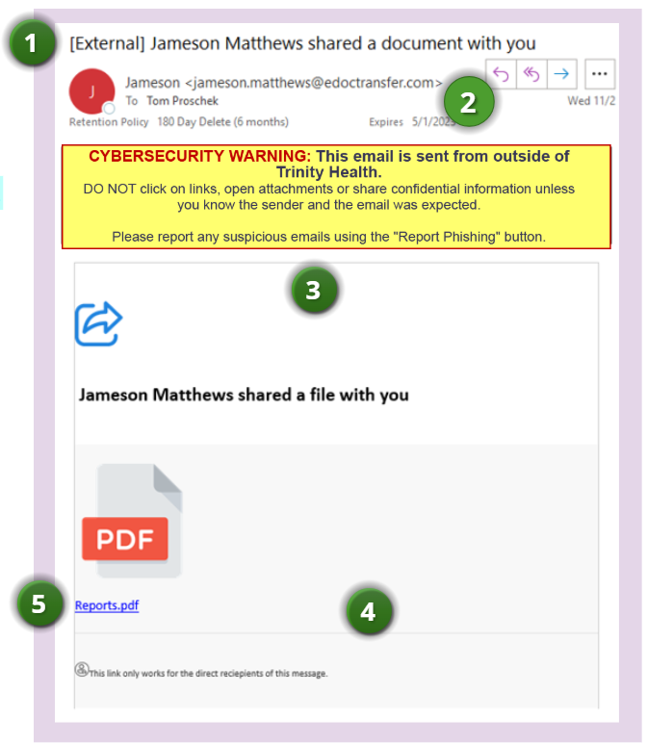
Phish Warning Signs
External Banner – Always be careful when reviewing messages from external sources.
Sender: Do you recognize the sender?
Expectations: Were you expecting this message?
Identifiers: Why is there no logo or contact information? Why is there no way to call the sender to verify its legitimacy?
Hyperlinks: Do not click on links, download attachments, or enter your credentials unless you verify the email is legitimate.

Slide 20
Click here to play the video

Slide 21
Attention to Detail
Keeping Systems, Devices, and Information Safe

Slide 32
Thank you for completing the Annual Security Awareness Training.

