Slide 1
Quality and Infection Prevention
March 2021

Slide 2
Agenda
  Informed Consent
  Using the VOICE Reporting Application
  Consulting Additional Physicians
  Doc Halo
  Verbal/Phone Orders
  Blood Usage
  Focused Review
  eCQM, eSTK-2, -6, eVTE-1, -2
  Infection Prevention Program

Slide 3
Informed Consent
Christel Bermel

Slide 4
Informed Consent
Place the order ‘Consent Confirmed as Present/Witness’ with the exact name of the procedure(s) that you are consenting. DO NOT USE abbreviations. If you are consenting for an ORIF of the left hip; you must write out Open Reduction-Internal Fixation of Left Hip’ in the order. Don’t forget to identify the laterality.
The name of the performing provider must match the signing provider at the bottom. (Provider names must be written out…Dr. First Name Last Name).
Perform informed consent with the patient and/or proxy including key elements
    Explanation of procedure
    Benefits, risks, and side effects
    Likelihood of meeting patient’s goals of care
    Any potential problems from procedure or during recuperation
    Reasonable alternatives
    Risks to not receiving care
    Role of participants in post-graduate education program or non-physician providers
The patient or proxy will write their interpretation of the procedure in the Description of Procedure.
If the provider is the witness to the patient or proxy’s signature, he/she must complete both the signature witness section and the provider signature portion.
If the RN witnesses the patient or proxy signature, it is only for the identification of the person signing the consent, it is not that informed consent has been given.

Slide 5
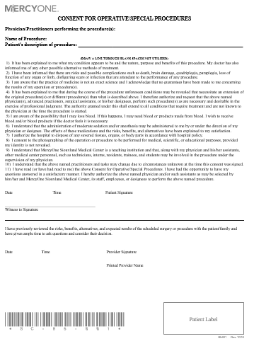
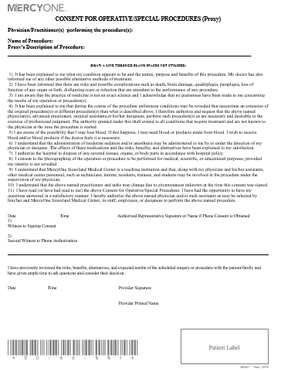
Consent Types
Patient
Proxy

Slide 6
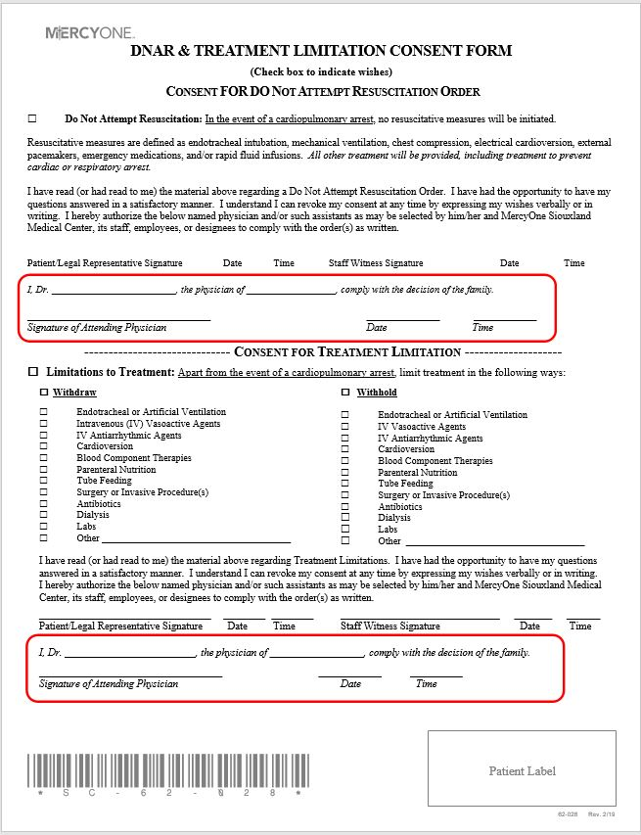
Informed Consent
DNAR consents must have Signature of Provider as well as date and time signed.
You will fill out the top OR bottom section of this consent according your patient’s wishes.

Slide 7
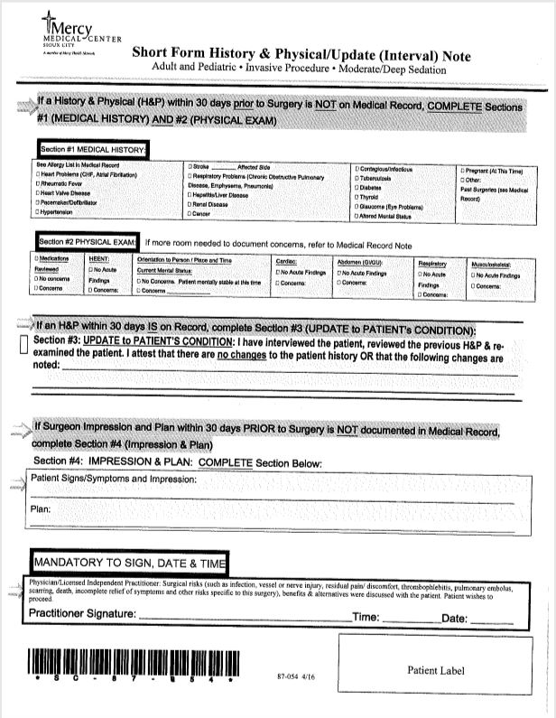
Informed Consent
Your Short Form History and Physical/Update Note must include signature, date and time.

Slide 8

Informed Consent
If you sign…
You must date
and time

Slide 9
Using the VOICE Reporting Application
Christel Bermel

Slide 10
What can we continually do to create a safety net?
Fundamentally change the way we think about errors and why they occur
Understand that human errors will occur
Reduce the fear of reporting, change culture
Work to reduce the frequency of errors
  Collect as much data as possible
  Examine mistakes and learn
  Redesign systems to prevent future errors

Slide 11
What should be reported?
Any situation that may adversely affect patient care
  Including Serious Reportable/Sentinel Events
Process/system concerns that may adversely affect patient care
Patient/Family Concerns
Equipment/product Concerns
Environmental Safety Issues
Employee Safety Concerns
Impaired Healthcare Provider
Inappropriate Employee or MD Behavior

Slide 12
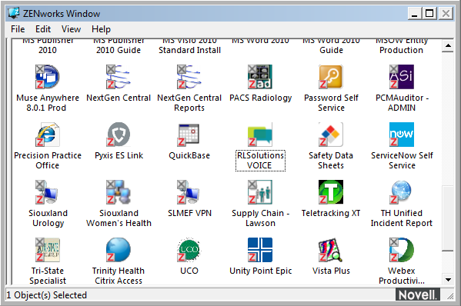
1. Using the Icon in your Applications (Zen) Window

Slide 13
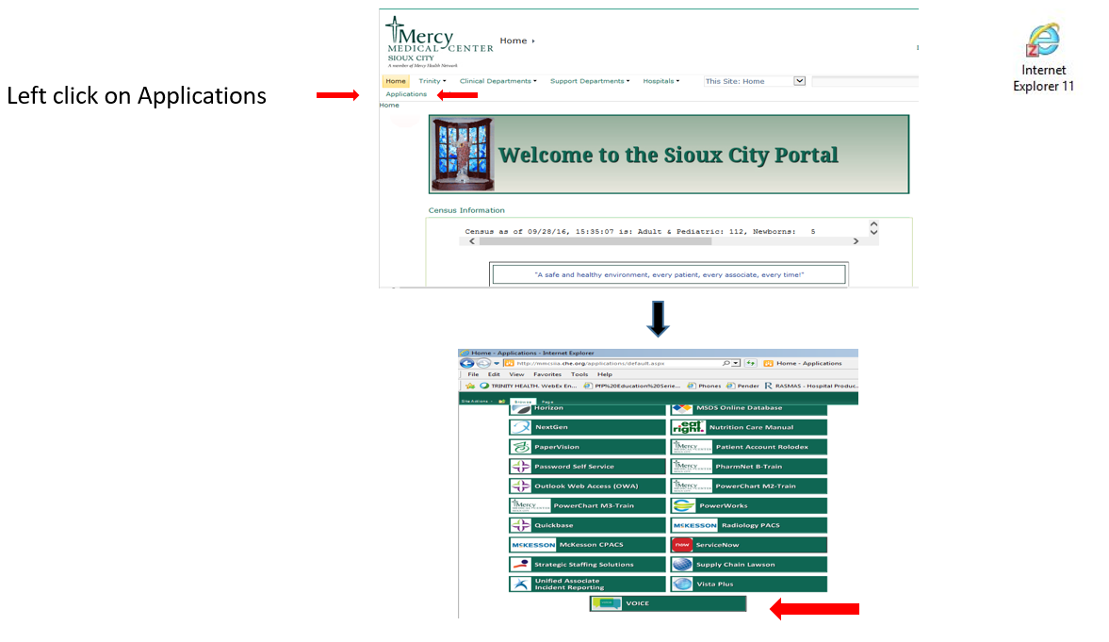
2. Using the link on our intranet site

Slide 14
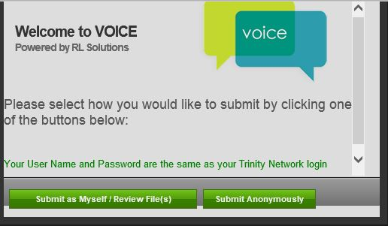
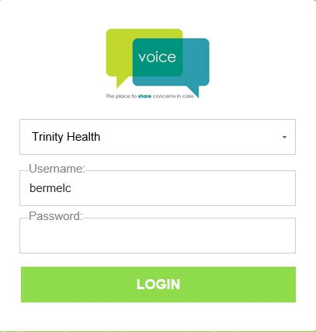
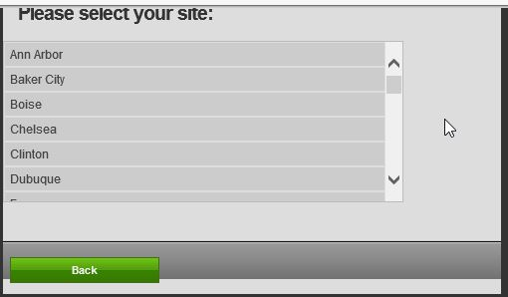
Using the VOICE Reporting Application

Slide 15
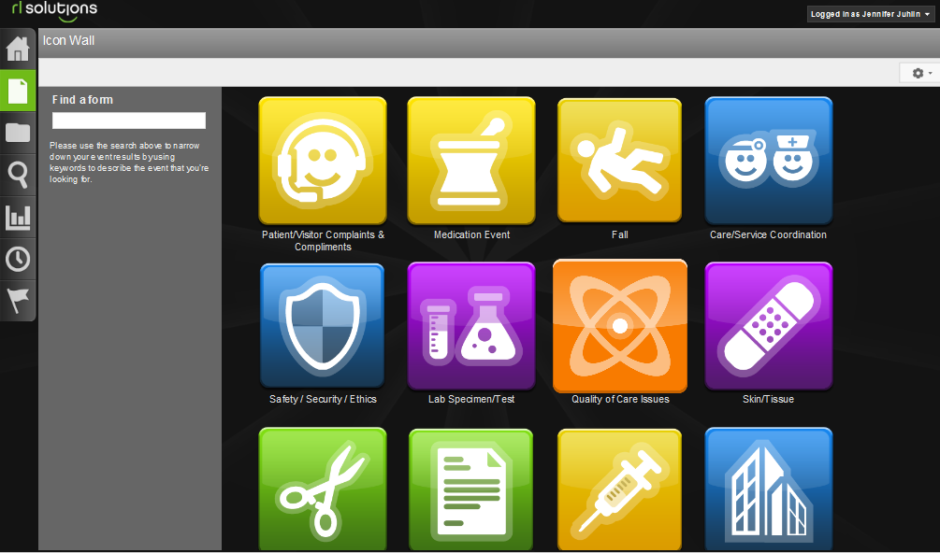
Choose the Icon that best identifies your report

Slide 16
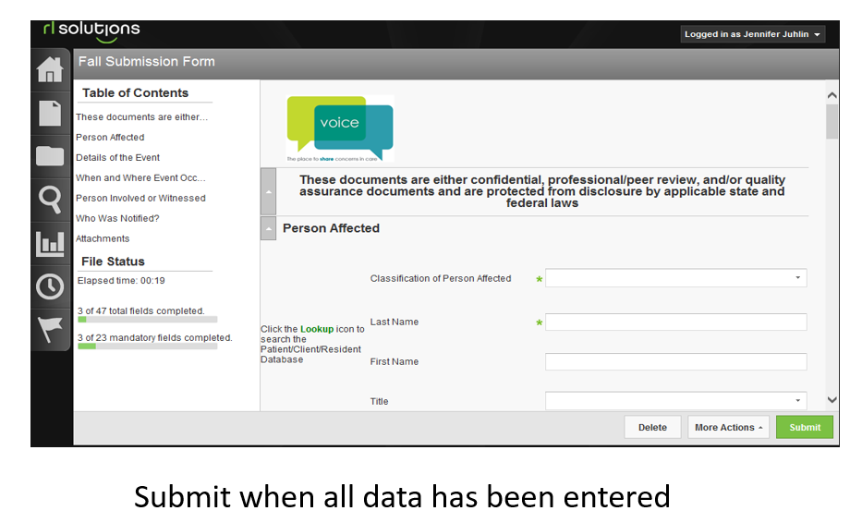

Include as much data as possible. The green (*) are mandatory fields that must be completed before submitting.
This is timed application. You have approximately 15 minutes to complete your submission. If you are getting interrupted or have to step away from completing, please save and exit.
When you sign back into VOICE, it will ask you if you would like to be directed to the last file you were working in.

Slide 17
Consulting Additional Physicians
Christel Bermel

Slide 18
Consulting Additional Physicians
Ordering Physician shall place Consult order into the patient’s EMR.
A Registered Nurse or Unit Secretary may place the Consult order if it is a telephone order. You must give them the name of the Provider you have contacted.
Direct physician to physician verbal communication is required between providers for all consultation requests.
The consultant should see the patient within 24 hours of notification and document his/her findings in a separate note. NOTE: The consultation of a midlevel practitioner does not meet the 24 hour requirement of the physician.
The physician on call is responsible for the consult.

Slide 19
Doc Halo
Christel Bermel

Slide 20
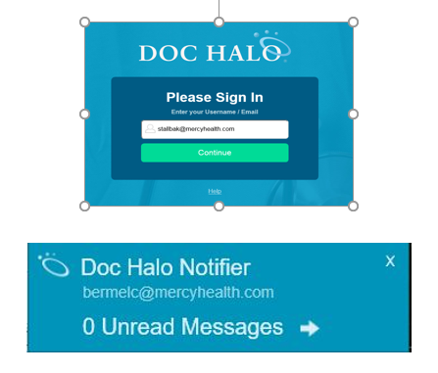
Doc Halo
No orders to be sent via Halo. Providers may use telephone order read back technique for urgent orders or enter the orders electronically. Policy EOC. 112
No orders are to be sent using your mobile device without using the Halo Application.
Images photographs or images are secure.
Written consent from patients must be obtained prior to acquiring photographs or images, and needs to be documented in the record. Policy 8743.5012
Good hand hygiene is needed before delivering patient care after using a device.

Slide 21
Verbal/Phone Orders
Christel Bermel

Slide 22

Verbal or Phone Orders
Verbal/phone orders are to be limited and restricted to:
  Emergent situations
  Clinical situations where it is impractical for the orders to be entered into the EMR (during a sterile procedure)
  Situations when providers do not have access to remote computer deices or the patient chart

Slide 23
Blood Usage
Christel Bermel

Slide 24
Blood Usage
Transfusion Principles:
Transfuse based upon the patient's clinical status/symptoms and hemoglobin (Hgb) concentration
Order and transfuse 1 unit at a time
Reassess the patient's Hgb and hematocrit (Hct) status prior to ordering the second unit
One unit may actually be the correct dose
Do not create patient expectation for a transfusion

Slide 25
Blood Usage
RBC Transfusion Criteria:
Hgb ≤ 7 gm/dL or Hct ≤ 21% in a clinically stable patient
Hgb ≤ 8 gm/dL or Hct ≤ 24% in patients with:
  Coronary artery disease
  Myocardial infarction, unstable angina, acute coronary syndrome (ACS), cardiogenic shock
  Congestive heart failure
  Myelosuppression
Patient with active bleeding (>1,500-2,000 mL) not responding to initial volume resuscitation
Patient with active need for increased oxygen carrying capacity documented by:
  Tachycardia (>100/min) and/or hypotension (<90 systolic) not corrected by volume replacement
  Chest pain
Transfusions per protocol: Exchange transfusion or dialysis procedure
Patient with intra-operative blood loss assessed by the Anesthesiologist and/or Surgeon
Patient with sepsis in the initial treatment phase when the ScvO2 or SvO2 < 70% and Hgb ≤10 gm/dL or Hct ≤30%
Scheduled Ambulatory/Outpatient transfusion per Physician order
Sickle cell crisis

Slide 26
Focused Medical Review
Bonnie Ryan/Christel Bermel

Slide 27
Focused Medical Review
All new provider are placed on focused medical review until 3 cases are reviewed and approved by the department chair.
In addition if any special privileges that are requested 1 case of each special privileges need to be approved also.
A form will be provide to you once you have the cases completed please return to quality.

Slide 28
eCQM
(Electronic Clinical Quality Measure)
Sandra Binder

Slide 29

Intro to eCQM’s
An eCQM (or eMeasure) stands for an Electronic Clinical Quality Measure
Based on discrete fields or encoded documentation : orders, contra-orders, VTE Advisor
Dependent on EHR time stamps
eCQM selections:
  eSTK-2 & -6 for TJC/CMS
  eVTE-1 for TJC/CMS

Slide 30
STROKE eCQM
Sandra Binder

Slide 31
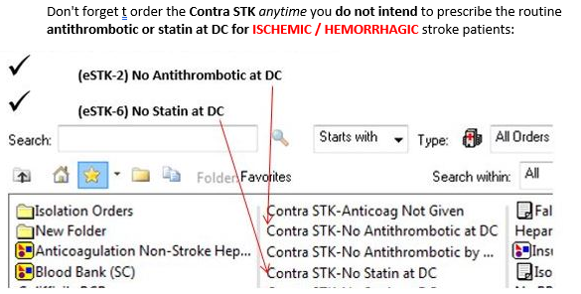
eSTK-2 Antithrombitic at DC for Ischemic / Hemorrhagic eSTK-6 Statin at DC for Ischemic / Hemorrhagic Stroke

Slide 32
Venous Thromboembolism eCQM
Sandra Binder

Slide 33

Venous Thromboembolism eCQM (eVTE-1)
Rationale
Preventable VTE is defined as:
“objectively diagnosed DVT or PE that occurred in a setting in which thromboprophylaxis was indicated but was either administered inadequately or not administered at all”
Preventable VTE was the
  2nd most common medical complication of postop patients
  2nd most common cause of excess length of stay
  PE is still the most common preventable cause of death among hospitalized patients
Retrieved from https://manual.jointcommission.org/releases/TJC2020B1/MIF0163.html
Excluded Populations
  Patients < 18y
  Length of stay greater than 120 days
  Comfort Measures Only ordered / documented
  Principal Diagnosis Code of VTE as defined in Appendix A, Table 7.03 or 7.04
  VTE Present at Admission
  Contraindications ordered for both mechanical and pharmacoprophylaxis

Slide 34


Venous Thromboembolism (eCQM VTE-1)
Physician Responsibility
VTE Prophylaxis is addressed on admit, verified daily and met by the ONE of the following:
  Mechanical prophylaxis ordered (SCD(s), TED hose, Foot pump)
  Pharmacoprophylaxis ordered (lovenox, heparin)
  Low Risk assessment per Cerner VTE Advisor
  Contra-indications: both pharmacological / mechanical
    Clinician needs to address with orders: medical reason for BOTH pharmacological and mechanical VTE prophylaxis not done
If a PE or VTE is suspected, obtain required diagnostic exam to confirm
    Be sure to clearly document the suspicion in your note
The Cerner VTE Advisor will cover the elements to assist in VTE measure compliance
VTE Prophylaxis must be addressed in orders if you do you not utilize Cerner VTE Advisor

Slide 35
Infection Prevention Program
Jodi Arnold

Slide 36

Why Do We Have an Infection Control Program?
The purpose of an
infection control program
is to prevent the spread
of infection from patient
to patient, patient to staff,
& staff to patient.

Slide 37
Infection Control Programs
Mandated by Several Organizations That Influence & Evaluate Hospitals:
OSHA: Occupational Safety and Health Administration
TJC: The Joint Commission
CDC: Center for Disease Control

Slide 38
What Do We Report?
Surgical Site Infections (SSI)
Central Line-associated Bloodstream Infections (CLABSI)
Catheter-associated Urinary Tract Infections (CAUTI)
Possible Ventilator-associated Pneumonia (PVAP)
Clostridium-difficile Infections
MRSA Bacteremia
Influenza Vaccination measures for patients
Influenza Vaccination measures for Employee, LIP, and student

Slide 39
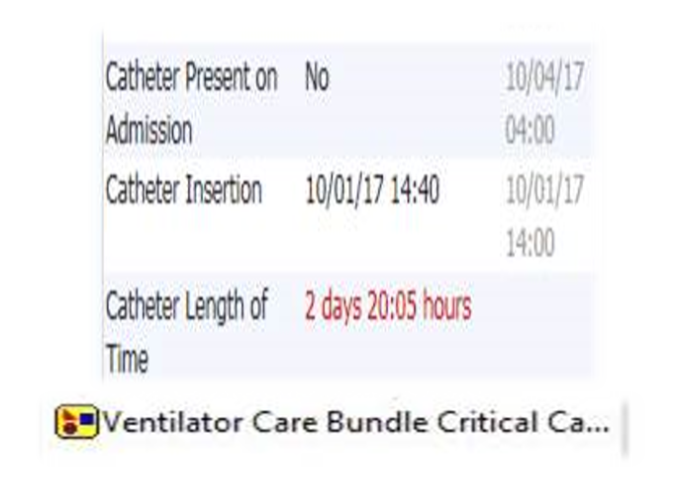
What is Your Role?…Prevention!
Watch EMR alerts and only use lines and catheters when necessary.
Remove as soon as possible.
Avoid femoral IV sites if able.
Use the Ventilator Care Bundle Critical Care order set to promote VAP prevention adherence

Slide 40
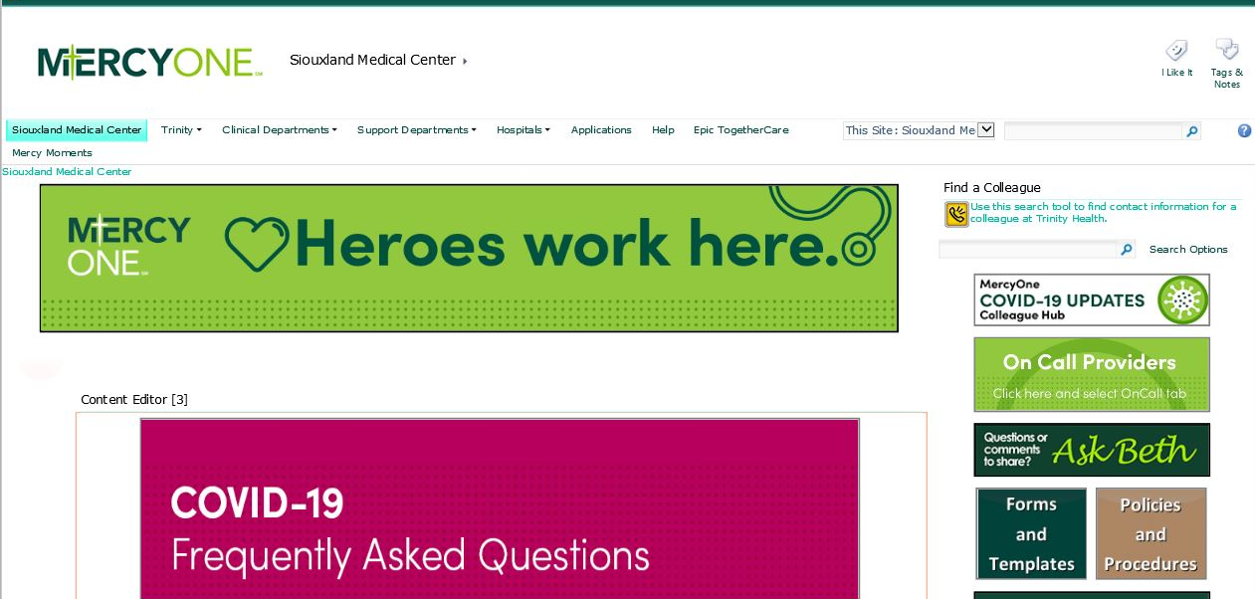
MercyOne COVID-19 UPDATES
Colleague Hub
Information is updating frequently. Review the Hub often.

Slide 41
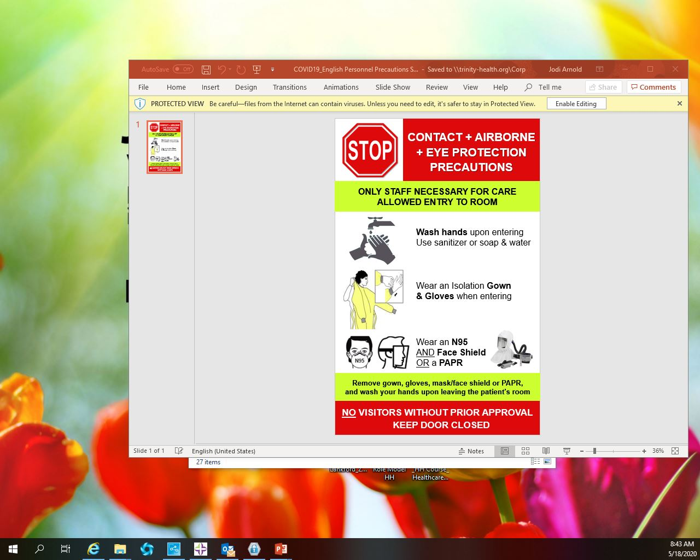
COVID-19
Uniform Infection Prevention practices in cohorts
Airborne + Eye Protection/Gown/Gloves for AGP (aerosolizing generating procedures)
Droplet + Eye Protection/Gown/Gloves for non AGP (aerosolizing generating procedures)

Slide 42
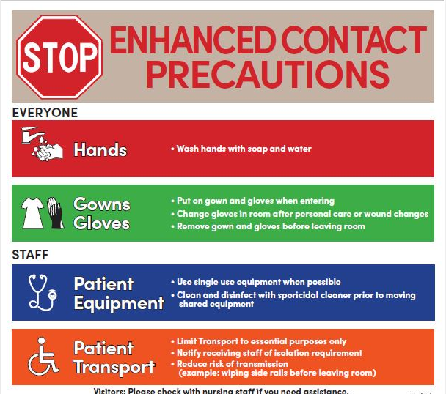
Isolation Precautions
Enhanced Contact Precautions
Ex: Clostridium difficile testing
Isolate for positive PCR even if toxin in negative.
Do not perform repeat testing during the same admission or test for cure.
*** Please refer to Treatment of Clostridium difficile hand out

Slide 43
Sepsis
Early Identification and Alerting:
  Electronic Health Record (EHR) sepsis screening begins in triage and continues throughout the patient’s stay. Identification is supported by electronic alerts and routine sepsis screening.
Why?
  Early recognition of sepsis is imperative. Implementation of the 3 hr bundle can reduce progression of sepsis.
  Septic shock is one of the most common causes of death in ICUs.
  Early identification and interventions of a septic patient can prevent the progression to severe sepsis and septic shock.
*** Please refer to SEPSIS hand outs

Slide 44
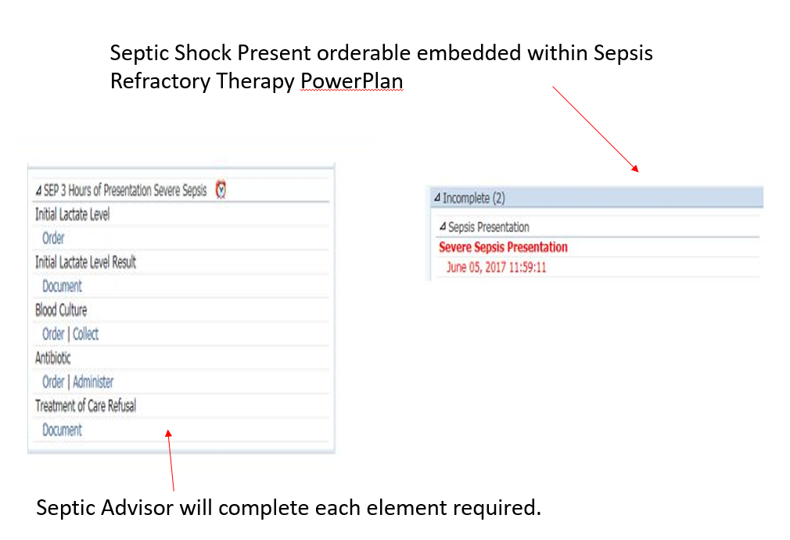
Sepsis

Slide 45
Sepsis 3-Hour Bundle
To be completed within 3 hours.
Obtain blood cultures prior to administration of antibiotics (ideally within first hour of care)
Administer broad spectrum antibiotics
Order lactate-use sepsis order set
Administer 30ml/kg crystalloid for hypotension or lactate > or = to 4mmol/L (no need for IV pump for fluid resuscitation within 1 hour, and consider Ideal Body Weight (IBW) for fluid volume calculation for BMI > 30)

Slide 46
Sepsis 6-Hour Bundle
To be completed within 6 hours.
Apply vasopressors (for hypotension that does not respond to initial fluid resuscitation) to maintain a MAP of >or=65mmHg
In the event of persistent hypotension after initial fluid administration or if initial lactate was > or = 4mmol/L, reassess volume status and tissue perfusion and document findings
Re-measure lactate if initial lactate elevated > or = 2 mmol/L
Physician/provider documentation should include an Attestation Statement indicating a repeat focused physical exam was performed after fluids to indicate a focused volume status and tissue perfusion reassessment or items in repeat focused exam are met

Slide 47
Thank you

