Slide 1
How to Submit a Patient/Staff/Visitor Complaint in VOICE
Barbara Grotting, RN, MSN, CPHQ
Director, Quality/Accreditation/Patient Safety

Slide 2
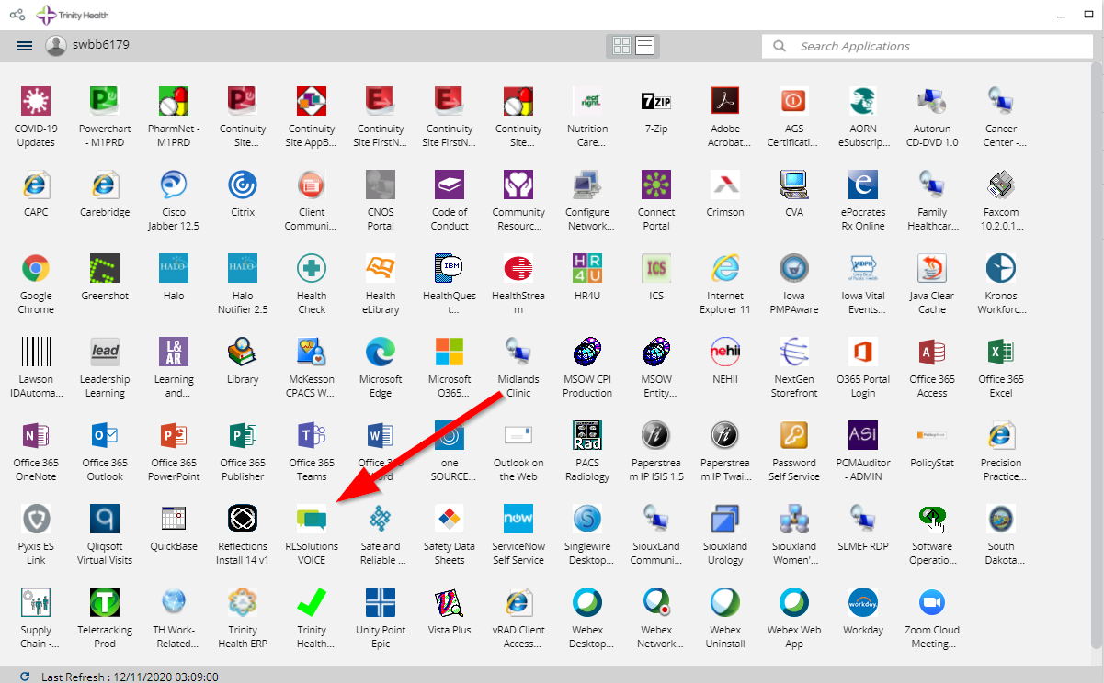
Click on the Icon in your
Zen Applications Window

Slide 3
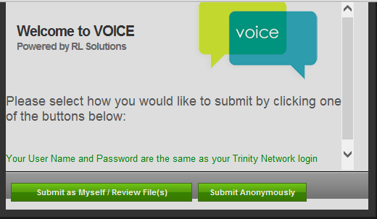
Choose to submit as yourself or anonymously

Slide 4
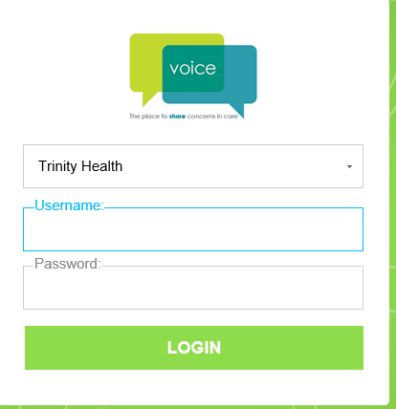
If you choose to submit as yourself you will log into the VOICE program

Slide 5
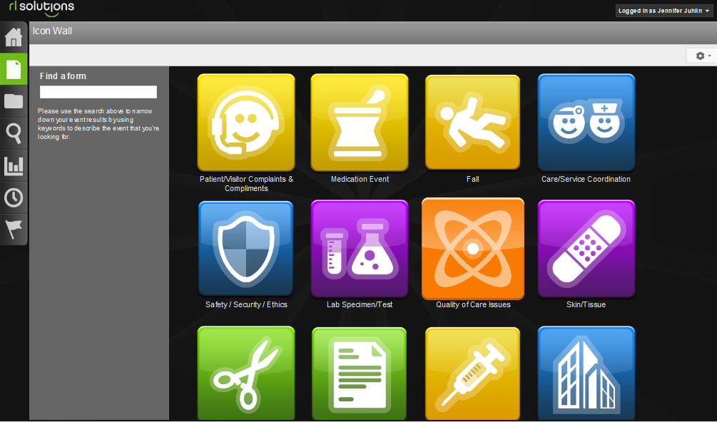
Choose Patient /Visitor Complaints & Compliments

Slide 6
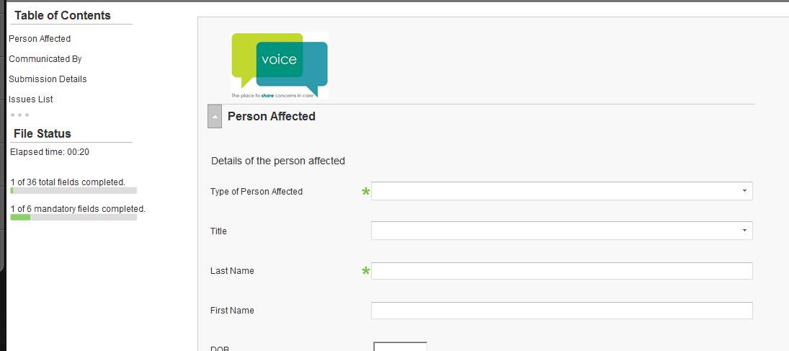
Include as much data as possible.
The green (*) are mandatory fields.
Click on submit when all data has been entered.

Slide 7
KEY ISSUES TO REMEMBER:
Please remember to put the unit the issue occurred on, so the right person (unit manager) will be tasked with the follow-up.
Patient MRN/FIN will be needed so the specific patient EHR can be reviewed.
Quality and Risk also receive all VOICE issues and will ensure proper follow-up has been done before closing.

Slide 8
Any questions please contact
Barbara Grotting 1-2263
or
Elizabeth Skinner 1-5653
or
Sue Froid 1-2253

