Slide 1
Welcome to the presentation!
We will begin shortly. A few reminders:
Please keep yourself on mute.
Use chat to make comments or ask questions.
Do not put your phone on hold—hang up and call back in if necessary.
The session is being recorded and will be available via HealthStream.

Slide 2
Key Changes in the 2021 Evaluation and Management (E/M) Office or Other Outpatient Visit Code Set
IAS Integrity & Compliance Professional Services Team October 2020

Slide 3
This is only for Office or Other Outpatient Services
Code set 99202 – 99215
Effective January 1, 2021
First major overhaul in more than 25 years specific to the E/M office visit guidelines

Slide 4
What we have today…
1995 and 1997 Documentation Guidelines
‘95 Guidelines = too vague
‘97 Guidelines = too strict (bullets)
Key Components of E/M
History
Examination
MDM
OR
Time
Greater than 50% spent counseling and/or coordinating care

Slide 5
Unintended EHR consequences…checking the box
Note Bloat
Copy and paste
Redundant and inaccurate information
Auto-population
Contradictory information
Non-relevant information

Slide 6
Goal…
Simplify the work of the provider and improve the health of the patient
Decrease administrative burden
Decrease unnecessary documentation
Documentation that is pertinent to the patient visit
Update office/outpatient E/M visit code set to better reflect the current practice of medicine

Slide 7
For 2021…
CPT revised E/M Office or Other Outpatient Visit code definitions and guidelines
Physician Fee Schedule CY 2021 Proposed Rule
Released August 3, 2020
Aligned E/M visit coding and documentation policies with changes laid out by the CPT Editorial Panel for office/outpatient E/M visits, beginning January 1, 2021

Slide 8
AMA CPT 2021 E/M Changes Summary
Deletion of code 99201
Revision of codes 99202-99215
Eliminating history and physical exam as elements for code selection
Providers should perform a “medically appropriate history and/or examination”
Components for level of service code selection:
Medical Decision Making (MDM); or
Time
Addition of a shorter 15 minute prolonged service code (99XXX)

Slide 9
New Level Selection for Office/Outpatient Services (99202-99215)
E/M level of service for office or other outpatient services may be based on:
Medical Decision Making (MDM)
Clarification provided in the guidelines to define the criteria contributing to the level of MDM
OR
Time
Total documented time spent by the provider on the date of the encounter
Including non-face to face services
Defined time ranges for each code

Slide 10
Medical Decision Making (MDM)
Level of Medical Decision Making Table
Assist in selecting the level of MDM
Used for office or other outpatient E/M service only
Includes four levels of MDM (unchanged)
Straightforward
Low
Moderate
High

Slide 11
Medical Decision Making Table

Slide 12
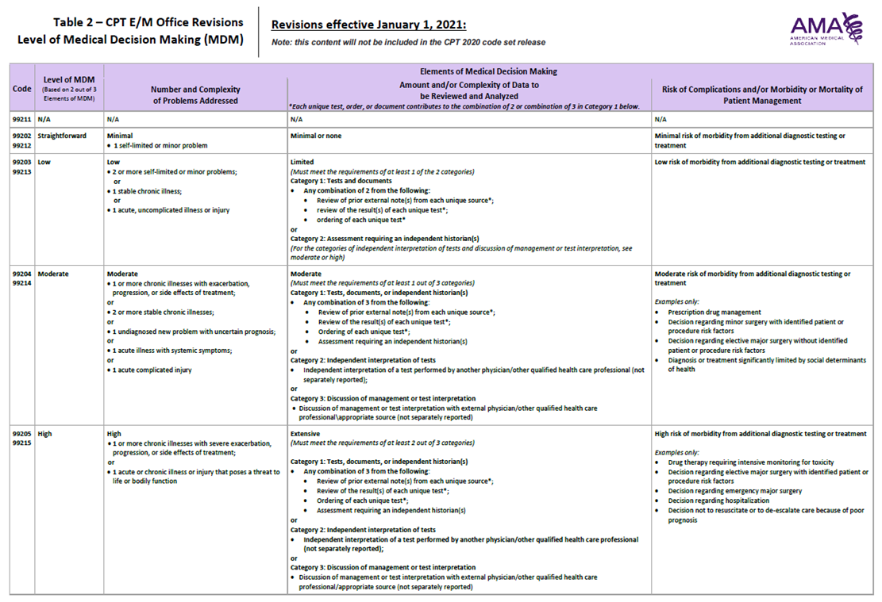
MDM: Number and Complexity of Problems Addressed
Minimal
Self-limited
Low
Stable chronic illness, uncomplicated, single problem
Moderate
Chronic illness with exacerbation, stable illnesses, new problem with uncertain prognosis, acute illness/injury
High
Severe exacerbation, threat to life or bodily function

Slide 13
MDM: Amount and/or Complexity of Data to be Reviewed and Analyzed
Three categories of data:
Tests, documents, orders, or independent historian(s)—each unique test, order, or document is counted to meet a threshold number
Independent interpretation of tests not reported separately
Discussion of management or test interpretation with external physician/other QHP/appropriate source (not reported separately)

Slide 14
MDM: Risk of Complications and/or Morbidity or Mortality of Patient Management
Minimal risk of morbidity from additional diagnostic testing or treatment
Low risk of morbidity from additional diagnostic testing or treatment
Moderate risk of morbidity from additional diagnostic testing or treatment (examples given on table)
High risk of morbidity from additional diagnostic testing or treatment (examples given on table)

Slide 15
Let’s take a look… Medical Decision Making

Slide 16
Putting it all together…
To qualify for a particular level of medical decision making, two of the three elements for that level of decision making must be met or exceeded (concept unchanged from current guidelines)

Slide 17
Time
Current:
Greater than 50% of time spent counseling and/or coordinating care
Only face-to-face time in the office setting
New:
Total provider time spent on the date of service may be used to select the level of E/M
Includes face-to-face and non-face-to-face time
Code set 99202 – 99215 only
Document total time

Slide 18
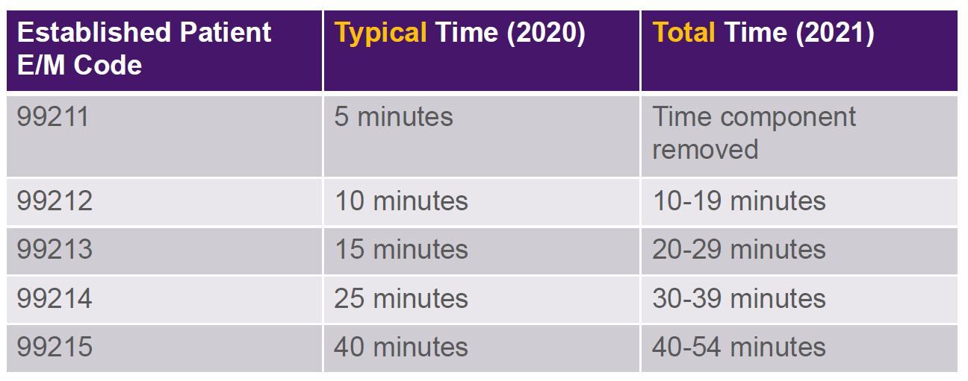
Per the AMA: The time that is counted is all the time on the calendar date of the encounter only. *Do not include clinical staff time

Slide 19
What’s Included in Time…
Physician/APP time includes the following activities, when performed:
Preparing to see the patient (e.g., review of tests)
Obtaining and/or reviewing separately obtained history
Performing a medically appropriate examination and/or evaluation
Counseling and educating the patient/family/caregiver
Ordering medications, tests, or procedures
Referring and communicating with other health care professionals (when not separately reported)
Documenting clinical information in the electronic or other health record
Independently interpreting results (not separately reported) and communicating results to the patient/family/caregiver
Care coordination (not separately reported)

Slide 20
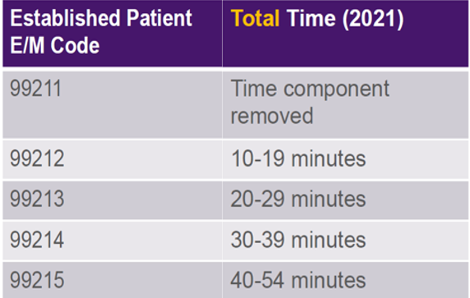
Let’s take a look again…Time

Slide 21
Prolonged Services
New code for prolonged services, each 15 minutes (99XXX)
Time unit reduced from the previous 60 and 30 minute prolonged service codes
To be reported only when the visit is based on time and after the total time of the highest level of service has been exceeded
Only used with 99205 or 99215
Allows for face-to-face and non-face-to-face care on the date of the encounter
Prolonged services of less than 15 minutes should not be reported

Slide 22
Things to Remember…
Changes are for office or other outpatient E/M services only
Level 1 new patient visit (99201) will be eliminated in 2021
The required history and exam are defined in the updated 2021 guidelines as “medically appropriate.”
No requirement that more than 50 percent of the visit be dominated by counseling or coordination of care
Need to document total time
Provider documentation should represent a cohesive, clinically relevant, patient encounter

Slide 23
And more…
Additional resources on pulse…
Coming soon
FAQs
Updates
https://intranet.trinity-health.org/web/integrity-audit-services/physician-resources

Slide 25
Contact us…
Margaret Nusbaum, BA, CPC, CRC
Manager, Integrity & Compliance
Nusbaumm@trinity-health.org
(734) 343-1922
Kathryn Strang, RN, BSN, CPC
Manager, Integrity & Compliance
Strangk@trinity-health.org
(734) 343-1509

Slide 26
Resources:
CPT Evaluation and Management (E/M) revisions
https://www.ama-assn.org/practice-management/cpt/implementing-cpt-evaluation-and-management-em-revisions
CPT Evaluation and Management (E/M) Office or Other Outpatient (99202-99215) and Prolonged Services (99354, 99355, 99356, 99XXX) Code and Guideline Changes
https://www.ama-assn.org/system/files/2019-06/cpt-office-prolonged-svs-code-changes.pdf
CPT Evaluation and Management
https://www.ama-assn.org/practice-management/cpt/cpt-evaluation-and-management

Slide 27
Resources
Office Evaluation and Management (E/M) CPT Code Revisions
Interactive based module, CME and AAPC CEU learning credit
https://edhub.ama-assn.org/collections/45311/medical-coding
CY 2021 Physician Fee Schedule and Other Changes to Part B Payment Policies Proposed Rule
https://www.federalregister.gov/documents/2020/08/17/2020-17127/medicare-program-cy-2021-payment-policies-under-the-physician-fee-schedule-and-other-changes-to-part
AMA Level of Medical Decision Making (MDM) Table
https://www.ama-assn.org/system/files/2019-06/cpt-revised-mdm-grid.pdf

